Slide 1

Power point karaoké
Agicap unconf (June 20th, 2023)

Slide 2
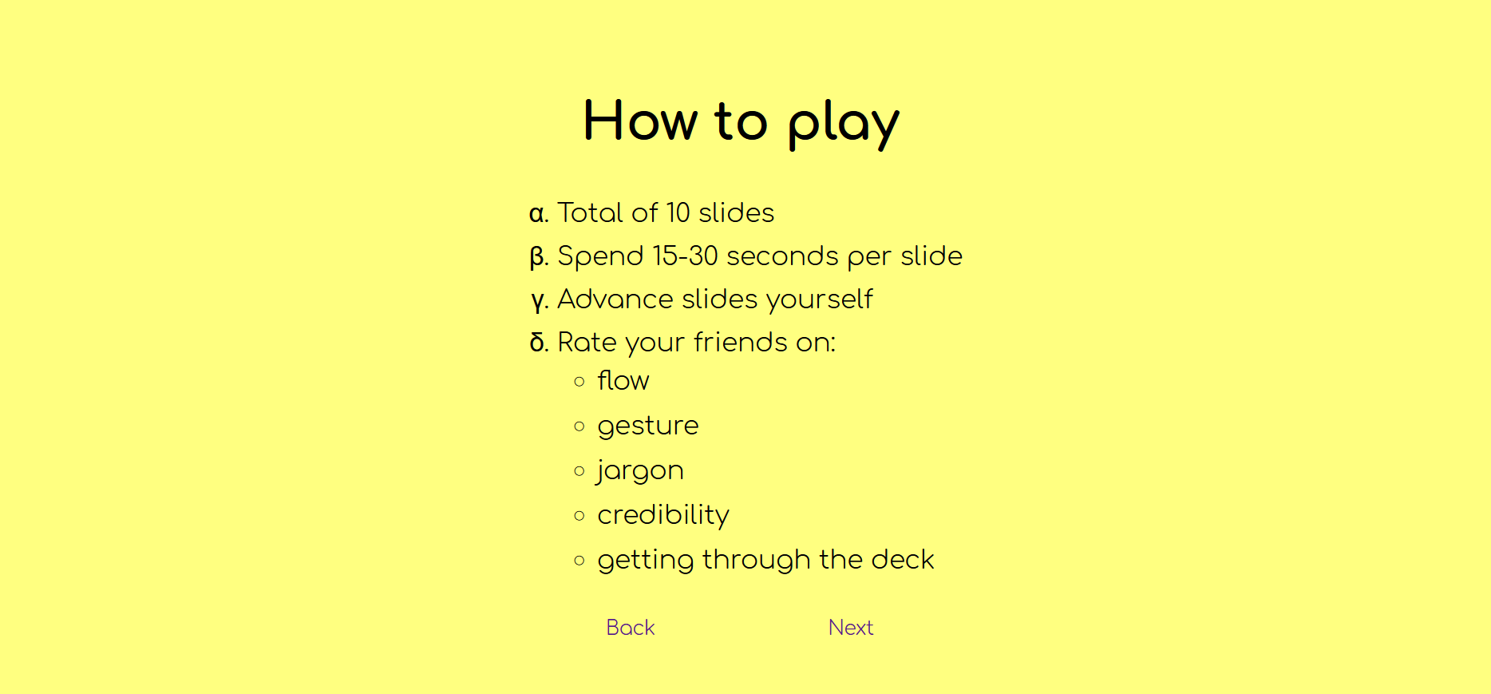
How to play
Spend 15-30 seconds per slide
Advance slides yourself
Rate your friends on:
Flow
Gesture
Jargon
Credibility
Getting through the deck

Slide 3
Les dessous de ChatGPT

Slide 4
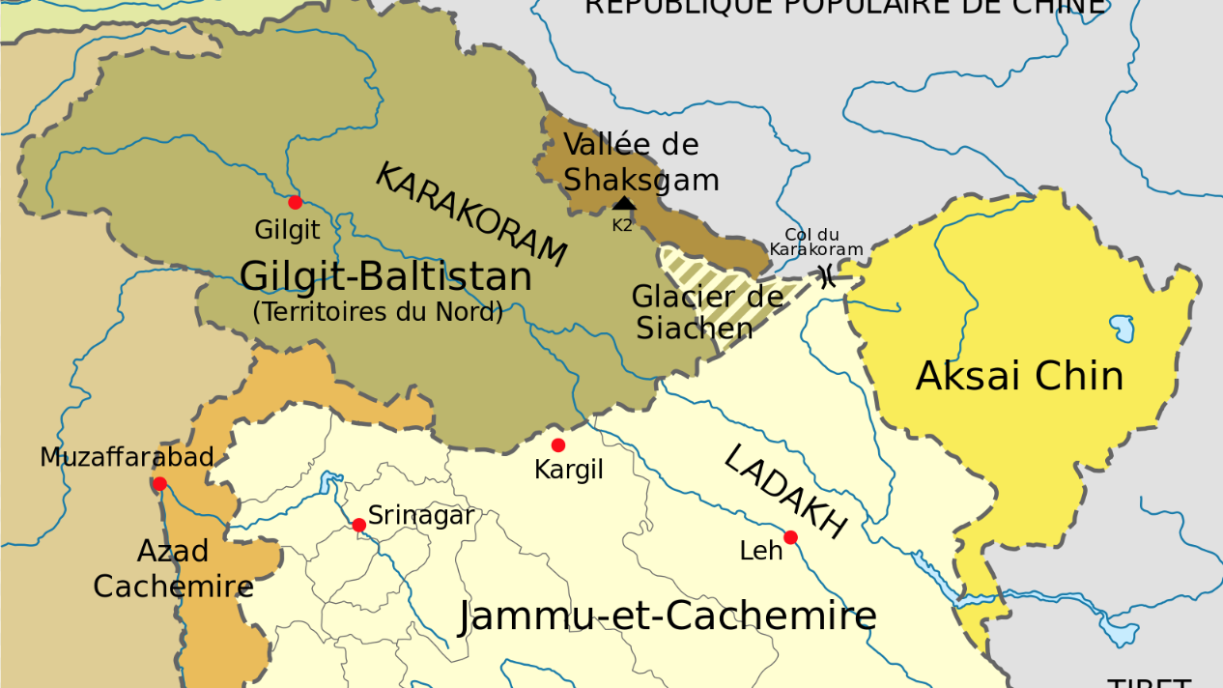

Slide 5
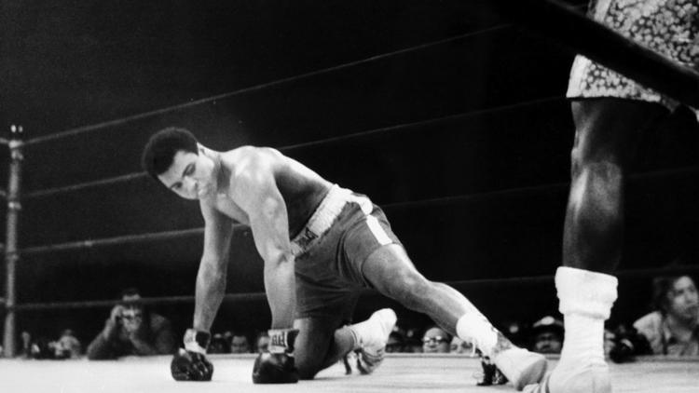

Slide 6
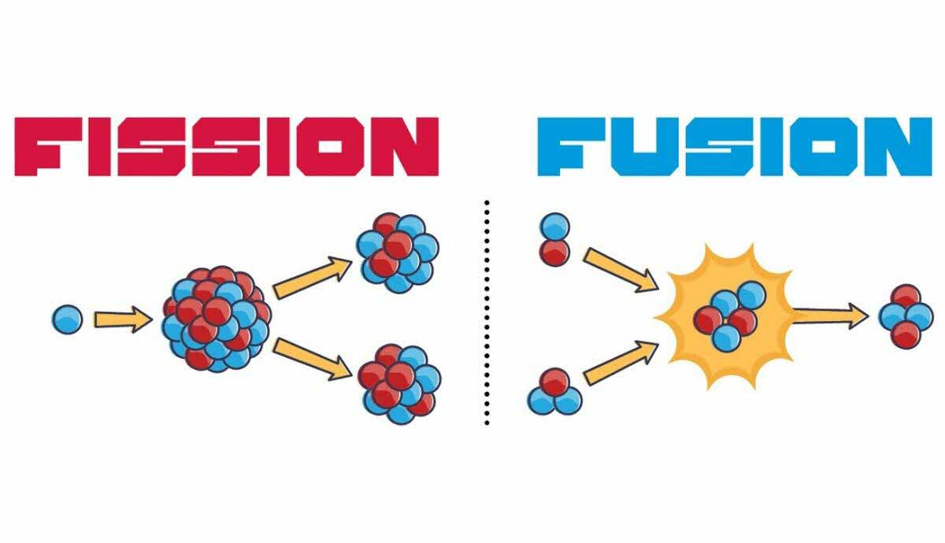

Slide 7
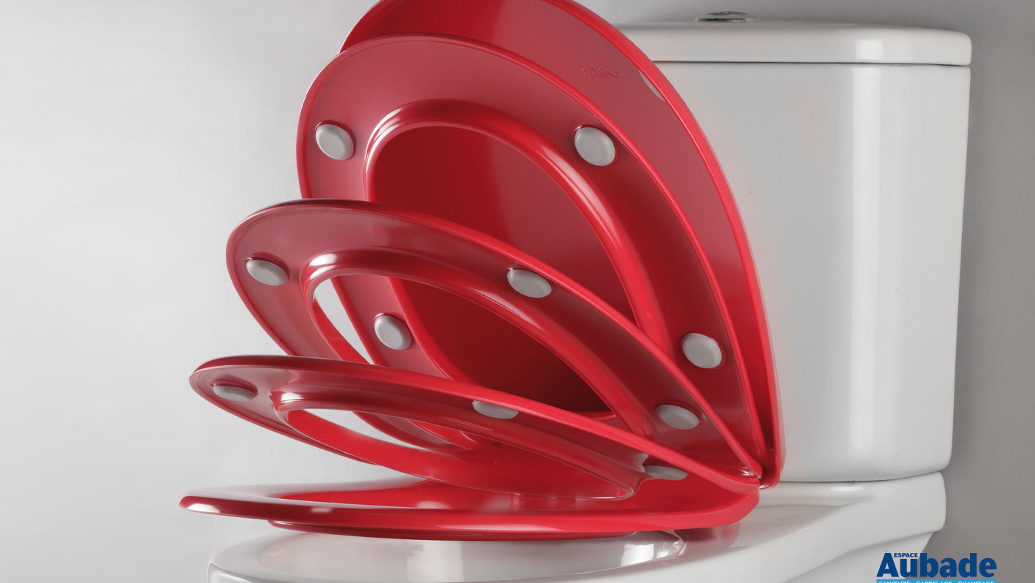

Slide 8
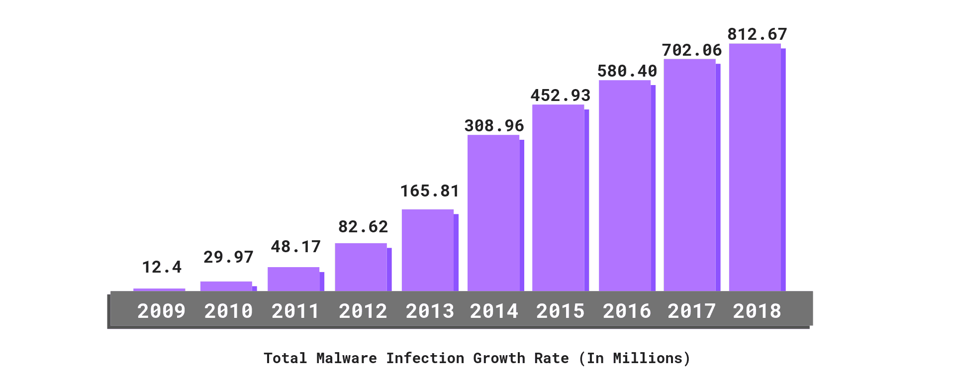

Slide 9
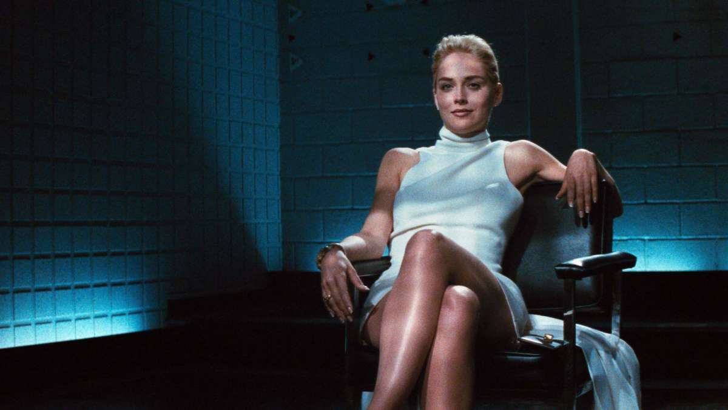

Slide 10
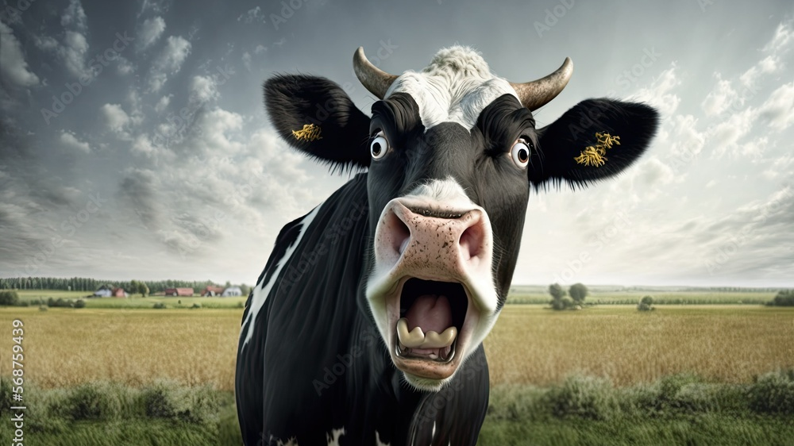

Slide 11
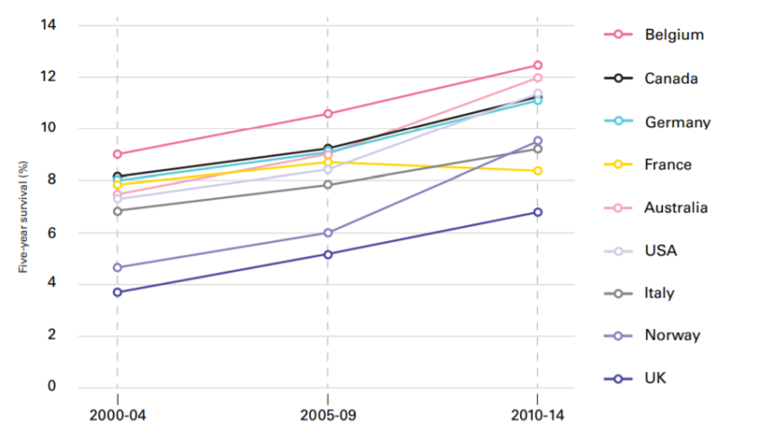

Slide 12


Slide 13
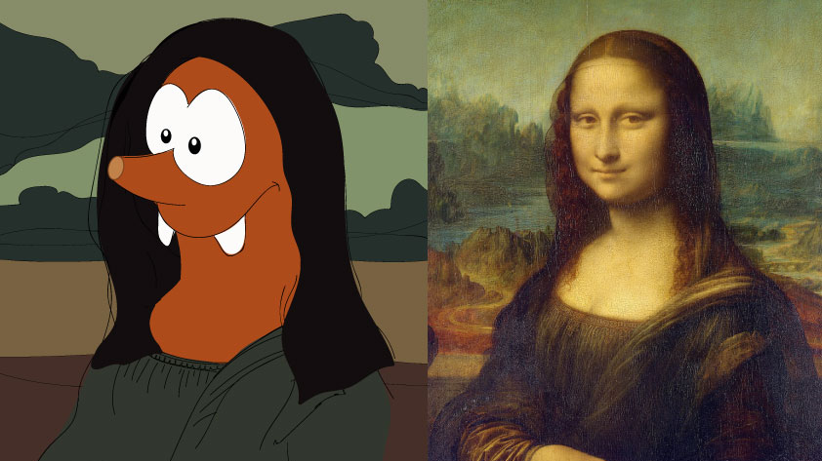

Slide 14
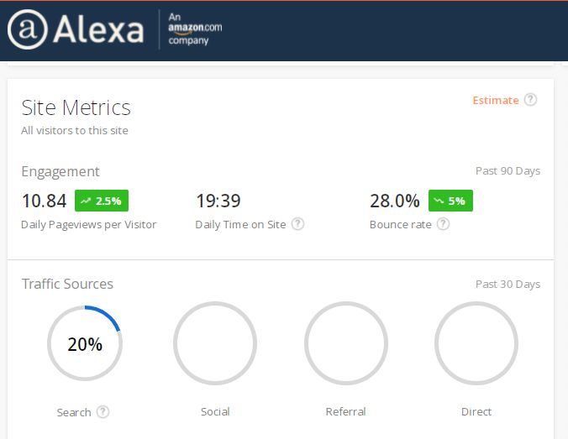

Slide 15
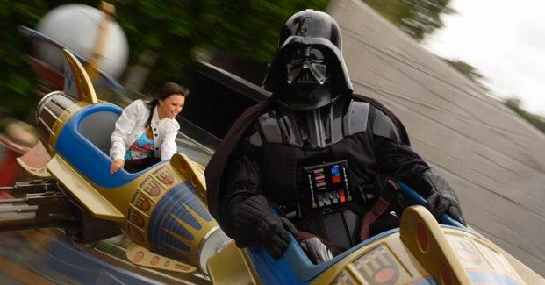

Slide 16


Slide 17
And you’re done!
Please give a round of applause

